Slide 1

Treating Animals and Animal Welfare
Batch: A7
Name of the students: Name of the guide:
B.Alekhya (154G1A0504) Ms. C.Rekha, M.Tech.,
M.Darshini (154G1A0520) Assistant Professor
A.Lakshmi (154G1A0542)
G.Naga sai lasya (154G1A0555)
Srinivasa Ramanujan Institute of Technology
Department of Computer Science & Engineering

Slide 2
Abstract
This application helps the animals which are not taken care by anyone. In this the user can help the animals which are in need. They can take the image of that animal and shares the location. After that the respective animal organizations who are registered in this application will get notifications and they will take necessary steps to save that animal. They will take care and also share the condition of that animal up to its recovery.

Slide 3
Contents
Introduction
Problem Definition
Proposed System
Modules
Design
Implementation
Project Planning
Tools and Technologies
References

Slide 4
Introduction
In this application users can help the animals which are in need and not taken care by anyone.
These animals are taken by any animal organizations who are registered in this application.
Users can see how the animal is taken care by them and can know the health condition and other details .

Slide 5
Problem Definition
When people see any animal is suffering or when it need any help they want to help those animal, but they do not have any approach or idea how to help those animals.

Slide 6
Proposed System
This application is one of the approach to help the animals in need.
In this application the user have to capture the image of the animal and share the location of the animal.
The registered organizations in our application will take care of that animals and they will share the condition of that animal until it’s recovery.

Slide 7
Modules
User:
Capture the image.
Share the location.
View the status of the animals.
Member:
Accept the requests.
Taken care of that animal.
Updating the animal status.

Slide 8
Design Data Flow Diagram
User
Details of an incident
Action taken by the Organizations
Input
Output

Slide 9
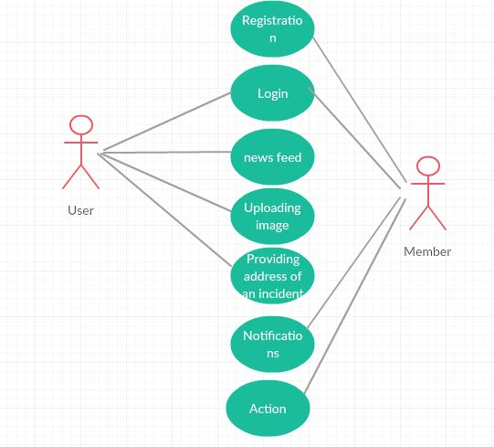
Usecase Diagram

Slide 10
Implementation
Software Required:
Android Studio

Slide 11
Android Studio
Android studio is a software used to develop Android apps and to Emulate them.
Android Studio is exclusively developed to make and run Android apps.
It is developed by Google.
Java language is used to code the apps.
Prerequisites to install Android Studio:
Java

Slide 12
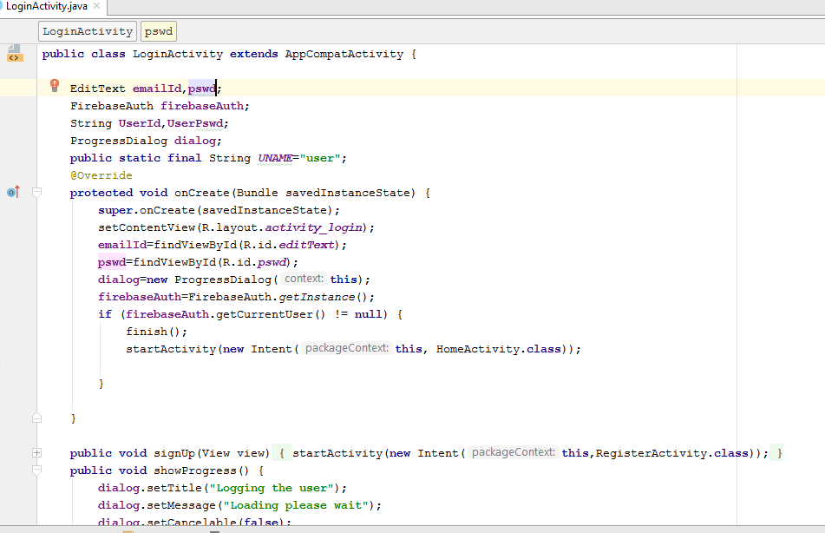
Code for Login

Slide 13
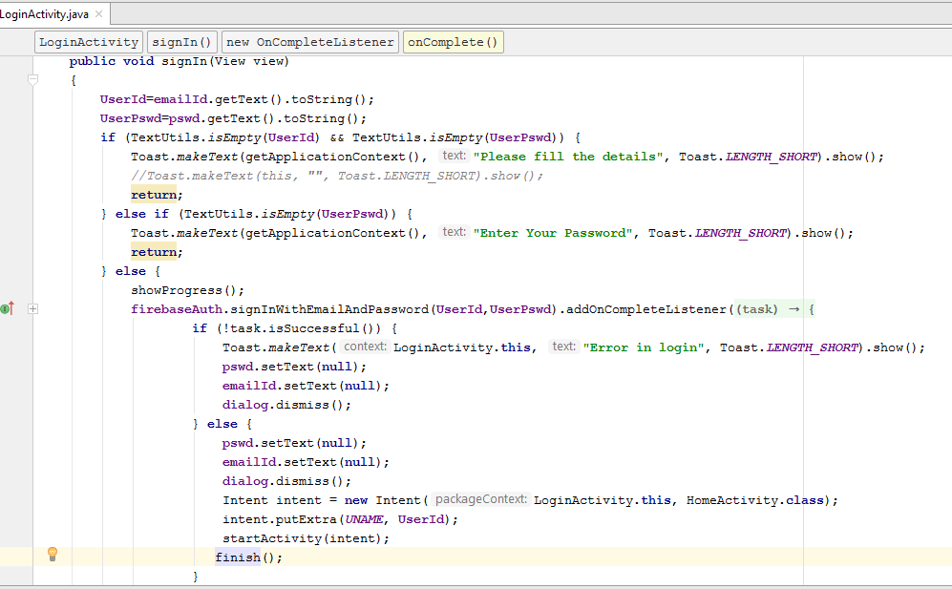
Contd….

Slide 14
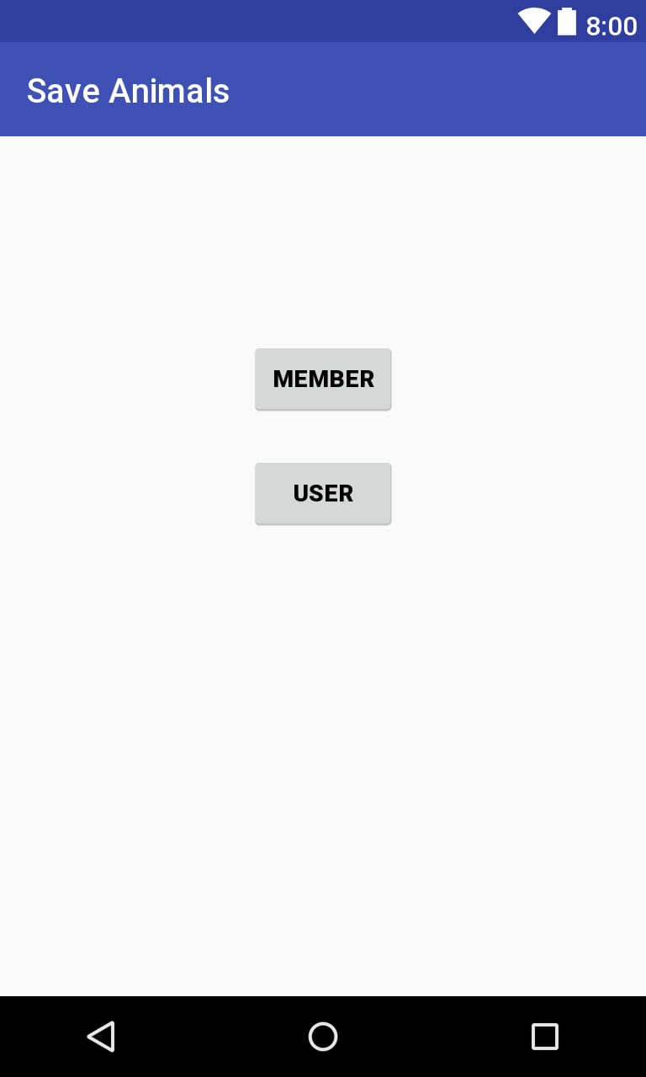
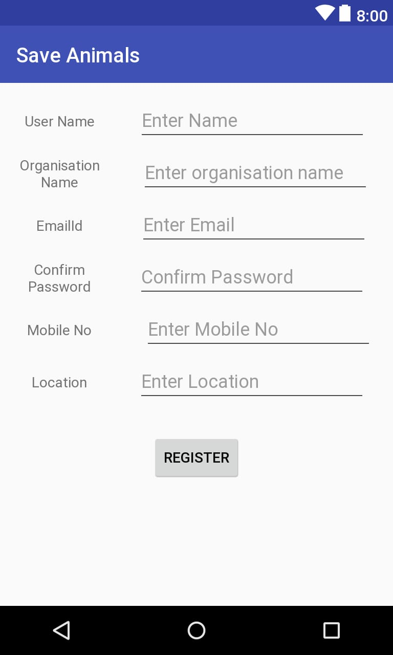
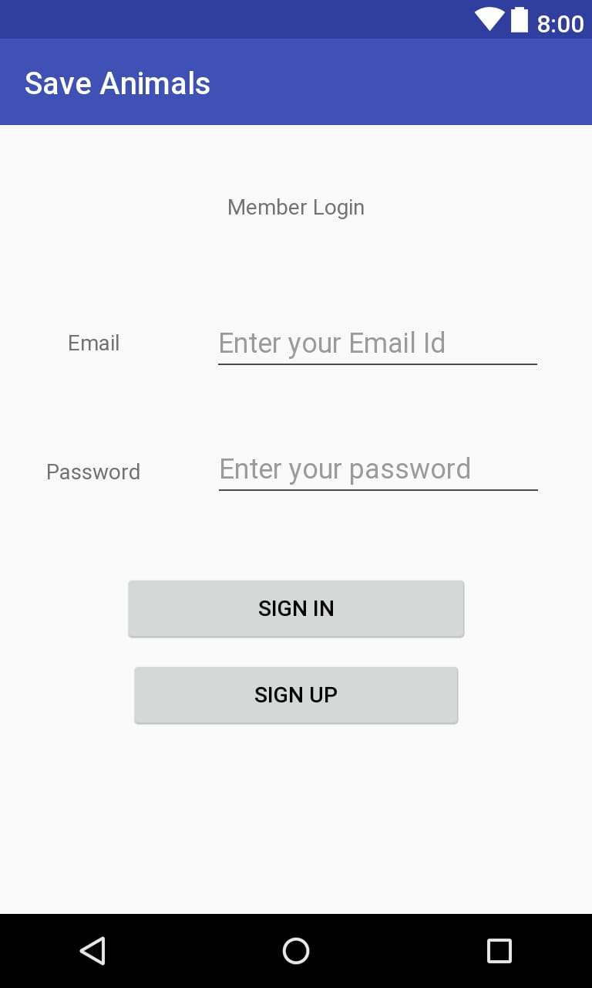
Screens

Slide 15
Project Planning
Schedule:
User module: 10 days
Member module: 15 days
SDLC model:
Agile model
Testing:
Espresso Testing

Slide 16
Tools and Technologies
Tools Used:
Android Studio 3.0.1
Hardware Requirements:
RAM – 8GB
Hard Disk – 1 GB
Programming Languages:
Java (Backend)
Extensible Markup Language (XML-Frontend)

Slide 17
References
https://en.wikipedia.org/wiki/Blue_Cross_of_India
https://github.com/LakshmiAvula542/ProjectWork
https://github.com/Alekhya97akki/UserModule
https://github.com/lasyagns/Project
https://github.com/DarshiniMedam/FinalProject

Slide 18
THANK YOU
Any Queries
?

